Slide 1



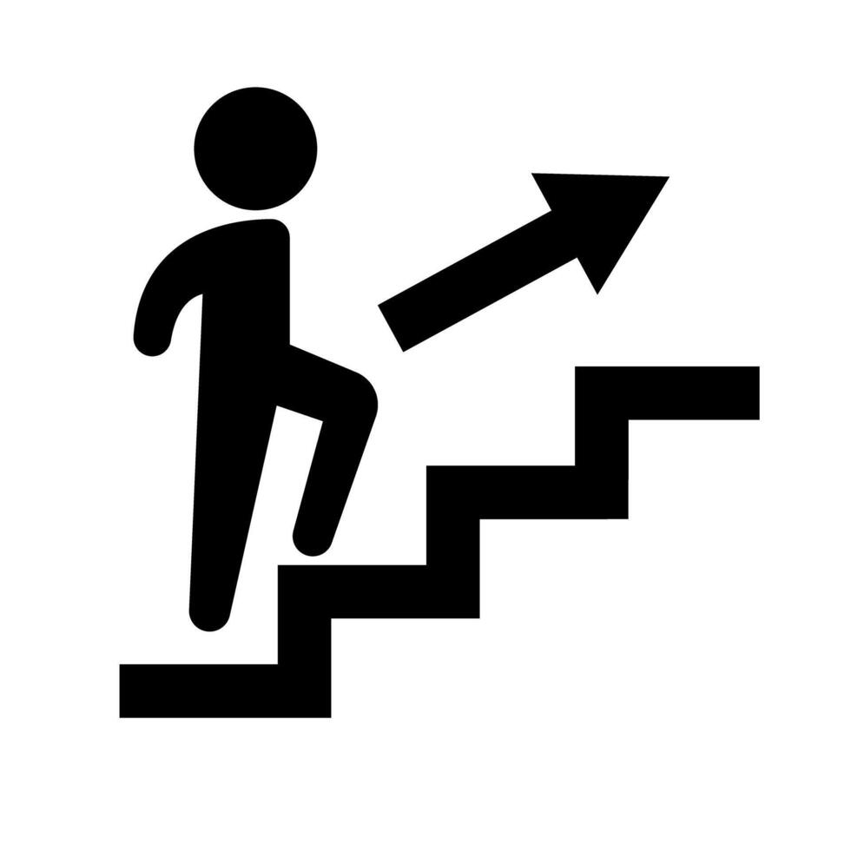

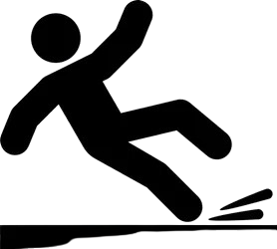
Stage | Behavior(Objectives) | Reward(Example scale)
Reach | Move gripper close to object
Grip | Close gripper when near
Grasp | Maintain stable grasp
Lift | Lift object above table
Hover/Approach | Move object to target bin
Success | Place in bin (one-time)
1.0
0.5
10.0
3.0
0.5
50.0
Penalties
Idle
(-0.4)
Drop
(-5.0)
Move Away
(-7.0)

